Slide 1
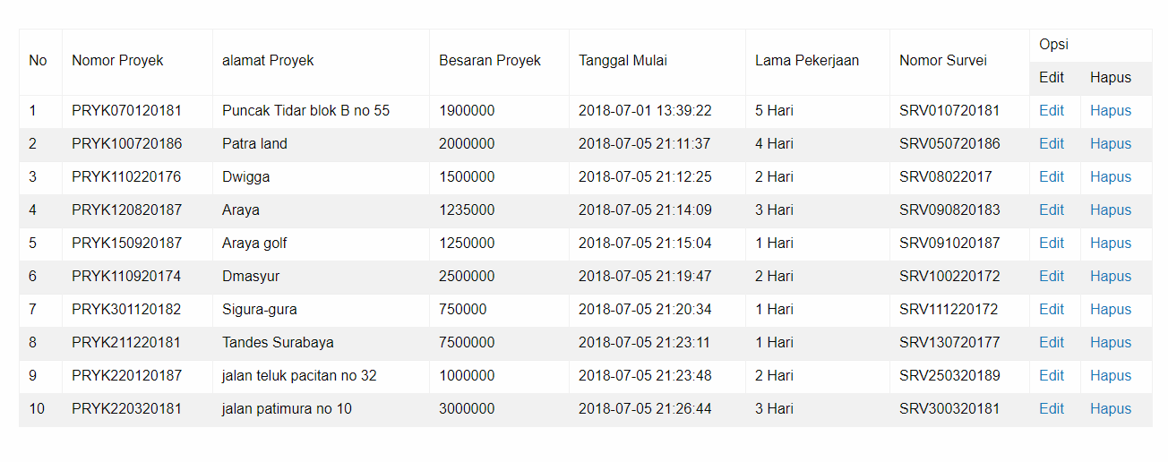

Slide 2
<?php
include_once("mysqli.php");
$query = "select a.nomor_proyek,b.lokasi_survei,a.besaran_proyek,a.tanggal_mulai,a.lama_pekerjaan,a.nomor_survei from tabel_proyek a,tabel_survei b where
a.nomor_survei = b.nomor_survei";
$result = $mysqli->query($query);
?>
<html>
<head>
<title>ARM Panel : Proyek</title>
<meta charset="utf-8">
<meta http-equiv="x-ua-compatible" content="ie=edge">
<meta name="viewport" content="width=device-width, initial-scale=1.0">
<link rel="stylesheet" href="https://cdnjs.cloudflare.com/ajax/libs/foundation/6.4.3/css/foundation-float.min.css">
</head>
<style>
body{
margin:0px auto;
padding-top:50px;
padding-left:50px;
padding-right:50px;
}
</style>
<body>
<table border="1">
<tr>
<td rowspan="2">No</td>
<td rowspan="2">Nomor Proyek</td>
<td rowspan="2">alamat Proyek</td>
<td rowspan="2">Besaran Proyek</td>
<td rowspan="2">Tanggal Mulai</td>
<td rowspan="2">Lama Pekerjaan</td>
<td rowspan="2">Nomor Survei</td>
<td colspan="2">Opsi</td>
</tr>
<tr>
<td>Edit</td>
<td>Hapus</td>
</tr>
<?php
if($result->num_rows > 0){
$i = 1;
while($row=$result->fetch_assoc()){
echo "<tr><td>".$i++."</td>";
echo "<td>".$row['nomor_proyek']."</td>";
echo "<td>".$row['lokasi_survei']."</td>";
echo "<td>".$row['besaran_proyek']."</td>";
echo "<td>".$row['tanggal_mulai']."</td>";
echo "<td>".$row['lama_pekerjaan']." Hari</td>";
echo "<td>".$row['nomor_survei']."</td>";
echo "<td><a href=\"edit.php?page=proyek&data=".$row['nomor_proyek']."\">Edit</a></td>";
echo "<td><a href=\"hapus.php?page=proyek&data=".$row['nomor_proyek']."\">Hapus</a></td></tr>";
}
}
?>
</table>
</body>
</html>

Slide 3
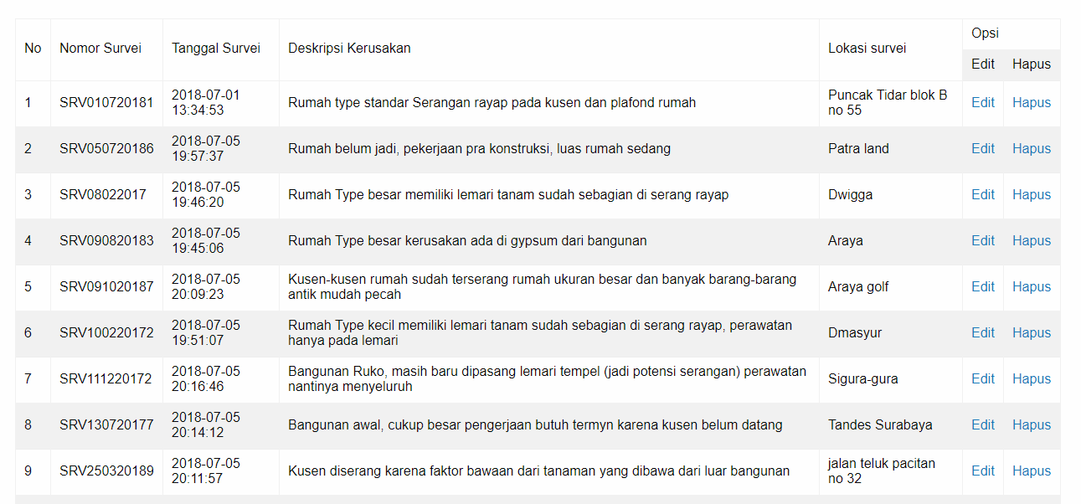

Slide 4
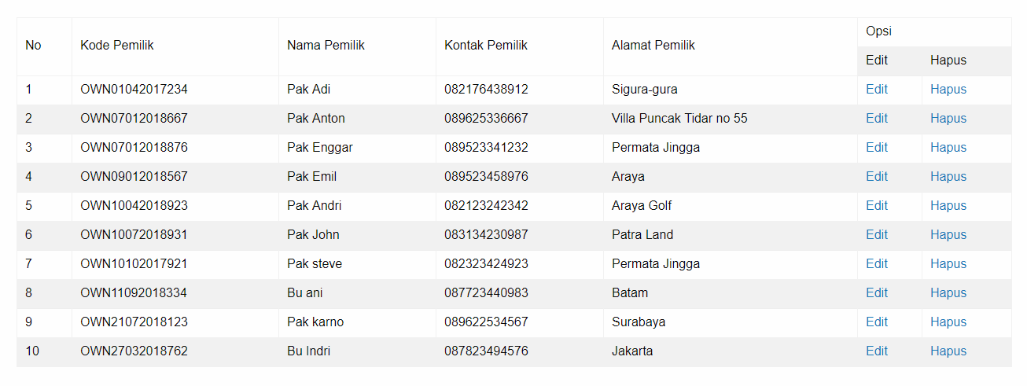

Slide 5
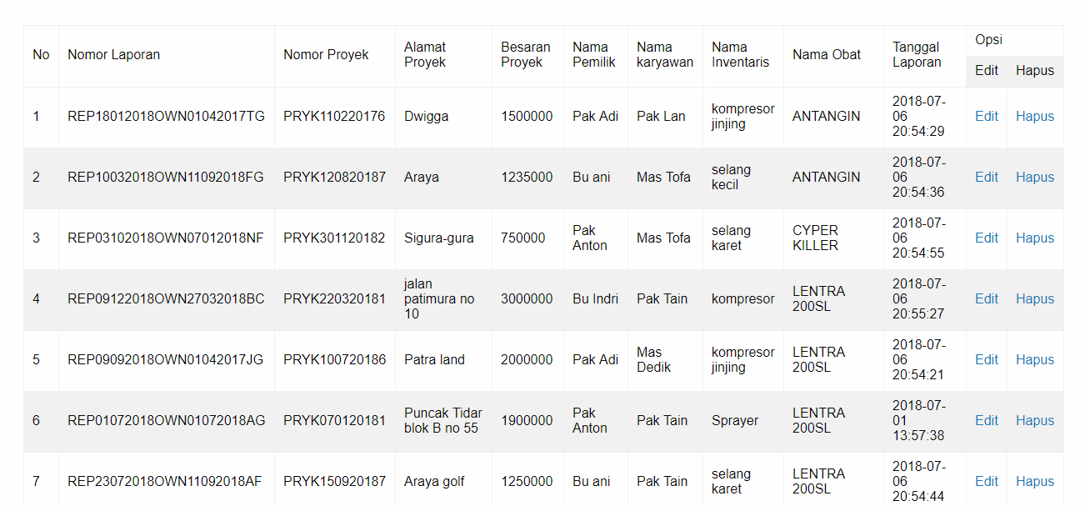

Slide 6
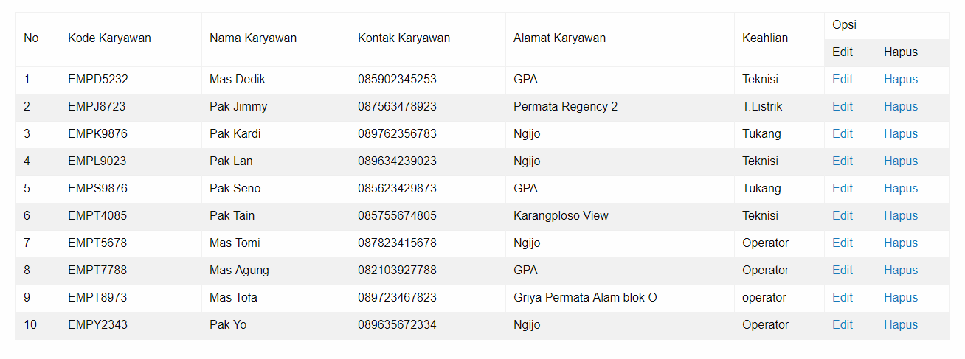

Slide 7
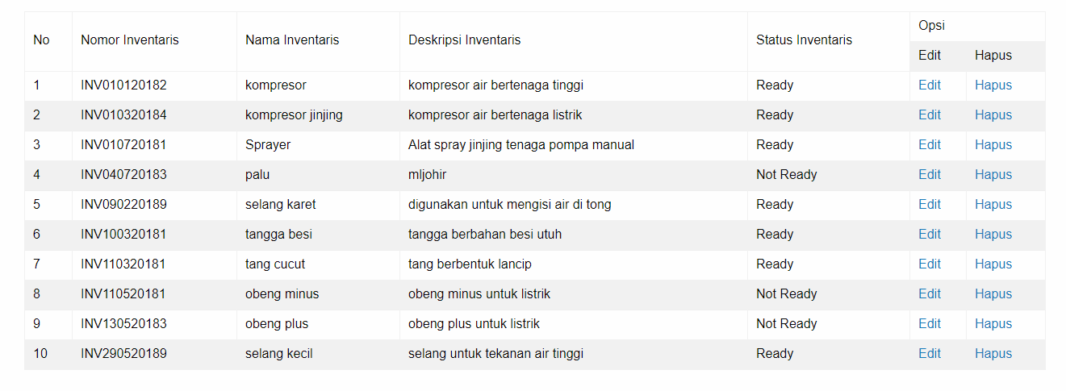

Slide 8
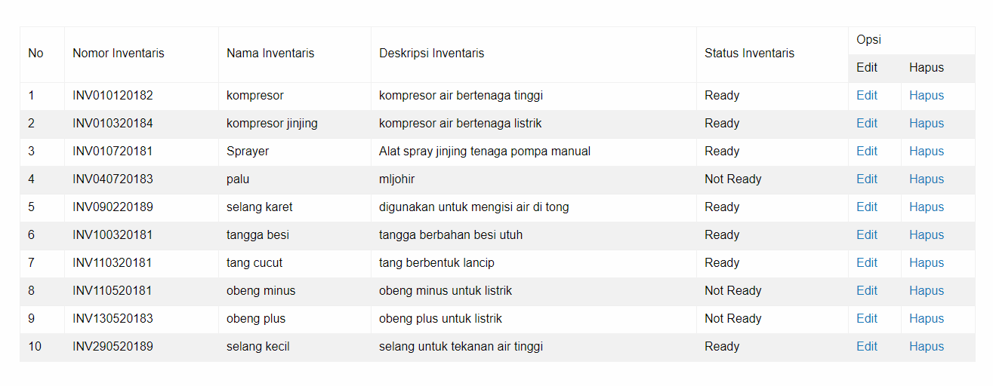

Slide 9
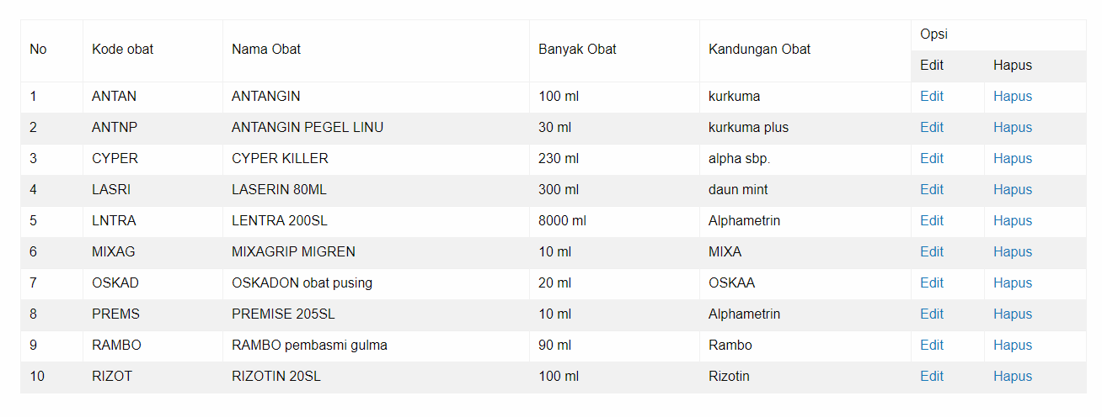

Slide 10
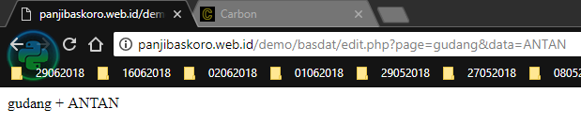
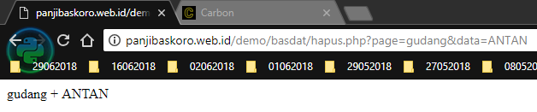

Slide 11
